Slide 1


UNIVERSITY INSTITUTE OF COMPUTING
Bachelors of Computer Applications
Sales Data Analysis
Team Member:
Choki Doji(22BCA10266 )
Tshewang Doji(22BCA11134)
Muntasir Imrose Prio(22BCA11212)

Slide 2

Sales Data Analysis: Project Overview
This project analyzes sales data to improve performance. It covers January to June 2024, using data from Salesforce and Excel.
Microsoft Excel was used with PivotTables, Charts, and Formulas for analysis.

Slide 3

Data Collection and Preparation
1
Data Extraction
2
Data Cleaning
Data extracted from Salesforce and Excel.
Missing values handled, duplicates removed.
3
Data Transformation
Key metrics calculated, like sales growth.
Accuracy verified with cross-validation, error rate under 1%.

Slide 4
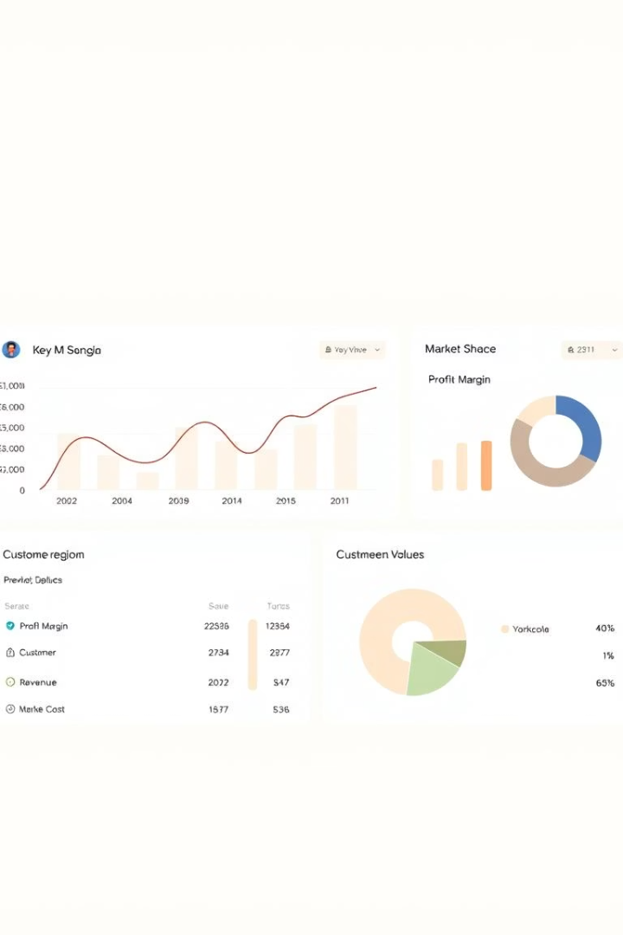
Key Performance Indicators (KPIs)
$2.5M
15%
Total Sales
Sales Growth
Exceeded target by 8.7%
Year-over-year growth
$150
Customer Acquisition Cost
Below target by 14.3%
All KPIs exceeded targets, reflecting strong sales performance.

Slide 5
Sales Performance by Region
Northeast
Southeast
Midwest
West
$800k, 32% of total sales.
$700k, 28% of total sales.
$600k, 24% of total sales.
$400k, 16% of total sales.
Northeast is the leading region, while the West lags behind.

Slide 6



Product Performance Analysis
Product A
1
$1M, 40% of sales.
Product B
2
$750k, 30% of sales.
Product C
3
$500k, 20% of sales.
Product D requires attention due to a 5% YoY decline.

Slide 7
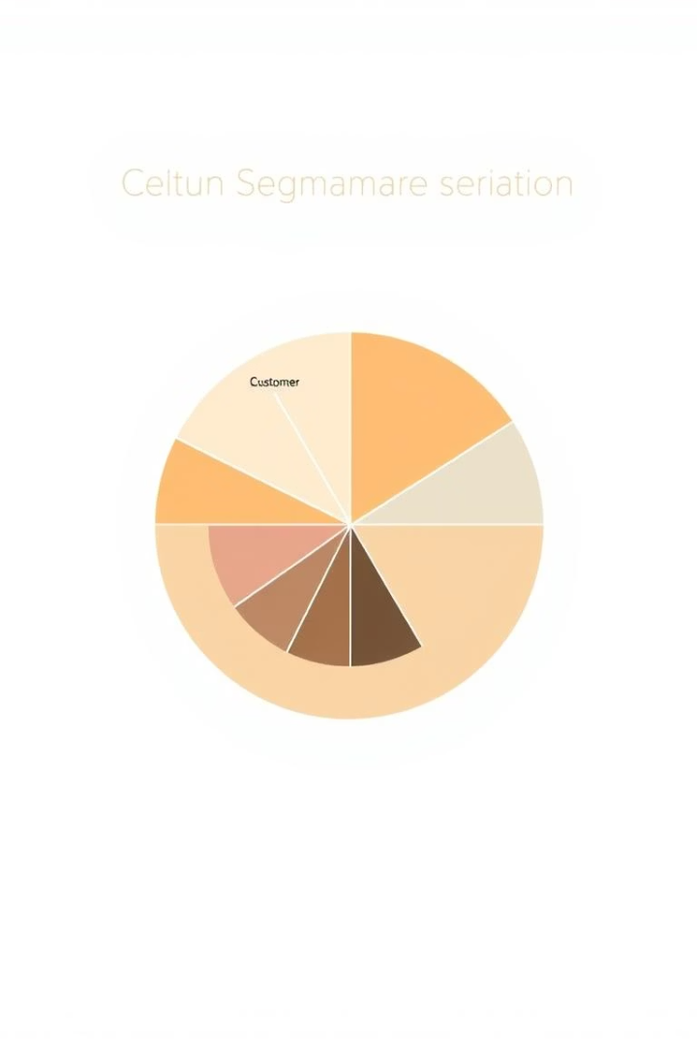
Customer Segmentation
High-Value
Medium-Value
20% of customers, 60% of revenue.
30% of customers, 30% of revenue.
Low-Value
50% of customers, 10% of revenue.
The high-value segment is critical, low-value segment requires review.

Slide 8
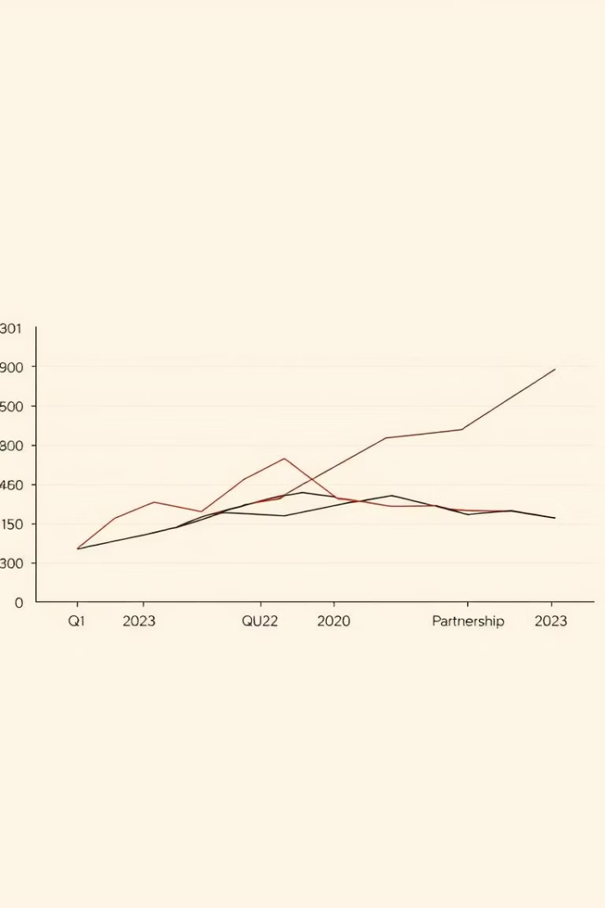



Sales Channel Analysis
Online Sales
$1.5M, 60% of sales.
Retail Sales
$750k, 30% of sales.
Partner Sales
$250k, 10% of sales.
The online channel is driving growth, while the partner channel is declining.

Slide 9
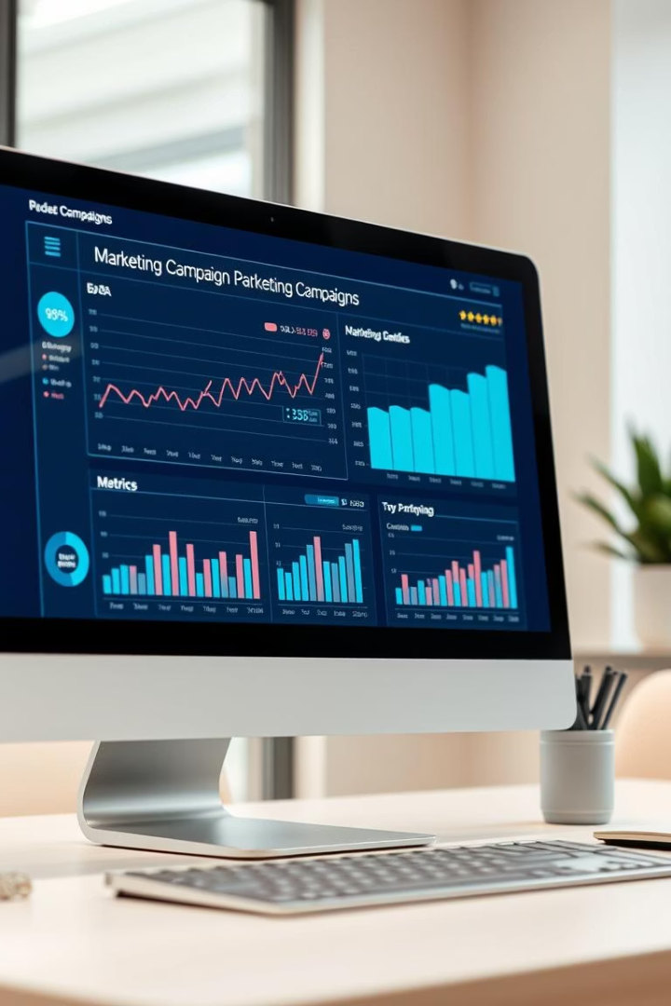



Marketing Campaign Effectiveness
Social Media
Email
Print Ads
ROI 200%, CAC $100.
ROI 150%, CAC $120.
ROI 50%, CAC $200.
Social media campaign is the most effective.

Slide 10

Recommendations
Focus on High-Value
Allocate resources to high-value customers.
Optimize Product D
Improve marketing for Product D.
Increase Online
Invest more in online sales.
Re-evaluate partner sales and shift budget to social media.

Slide 11

Conclusion
Data-driven insights significantly improve sales performance.
Continuous monitoring and analysis are essential.
Implement recommendations to achieve targets.
Next steps: Monthly reviews with updated Excel report.

